Slide 1



DEPARTMENT OF COMPUTER SCIENCE & ENGINEERING
Domain Winter Winning Camp 2023
Subject Name: DBMS
Day: 9
Topics Covered:Introduction to Mongo DB Atlas, SDLC, Android with Kotlin
DISCOVER . LEARN . EMPOWER

Slide 2
These points related to Day wise topic should be included :
Prerequisite of topic : MySQL or any other database, text editor and execution of programs.
Objective: As a document database, MongoDB makes it easy for developers to store structured or unstructured data. It uses a JSON-like format to store documents.It elucidates concepts related to Mongodb. The students will get hands- on experience in working with NoSQL and Mongodb.
Outcome: After completion of the course, the students will be able to understand the working of NoSQL, Mongodb, its features.

Slide 3

MongoDB Atlas
MongoDB Atlas is a cloud service by MongoDB.
It is built for developers who'd rather spend time building apps than managing databases. This service is available on AWS, Azure, and GCP.
We can use MongoDB's robust ecosystem of drivers, integrations, and tools to create faster and spend less time managing our database.
MongoDB Atlas is a great option for those who don't have the time or resources to manage all the infrastructure needed for a MongoDB cluster.
You can have a cluster up and running in minutes, allowing you to focus on your application instead of managing a database. And with the free tier, it's easy to start exploring.
Features:
Features of MongoDB Atlas include compliance, scalability, availability, and best-in-class automation. MongoDB Atlas lets us use the complete ecosystem of MongoDB’s integrations, drivers, and tools to save time and make database management relatively easy.

Slide 4
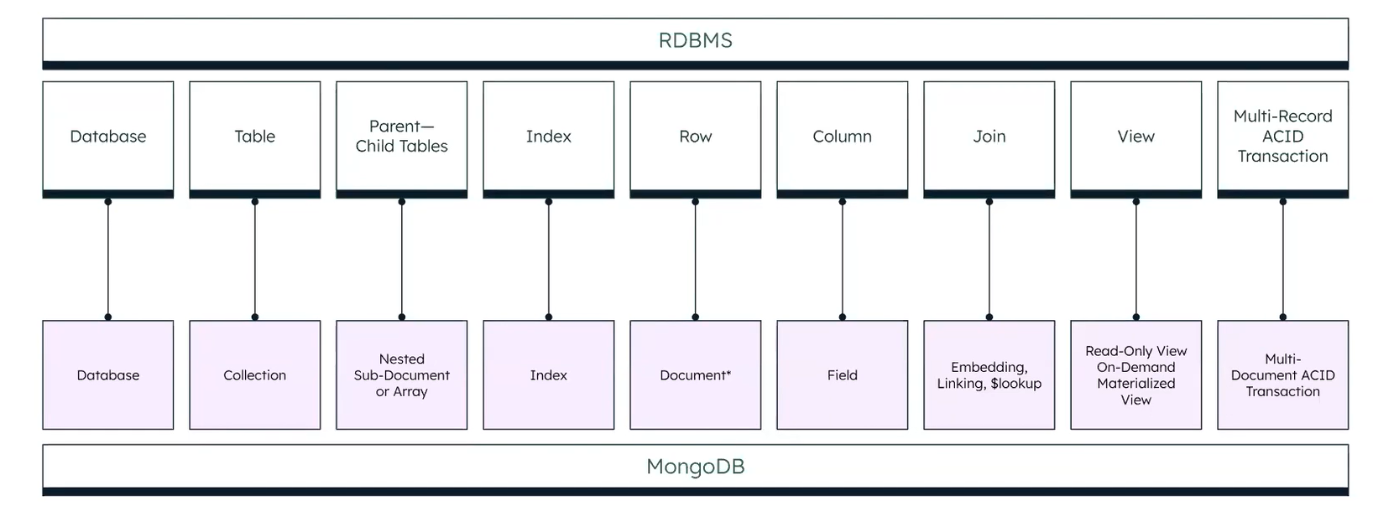
Some Terminology: A Comparison

Slide 5
Create An ATLAS Account
STEP 1. Visit the official MongoDB Atlas page to create a free-tier account.
STEP 2. Click on Try Free, which will take you to a registration page. Create your account here by filling in details or Sign Up using Google.
STEP 3. Accept the terms and conditions.
STEP 4. Provide details of your project and press the Finish button.
STEP 5. Choose and deploy a cloud database from the given types. These are low-cost and efficient to use. For now, let us choose the free shared tier.
STEP 6. Create a cluster. Here, we get to choose between M0, M2, and M5 cluster tiers. Let us go for the shared cluster type.
STEP 7. Choose a cloud provider and the desired region and click on Create Cluster.

Slide 6
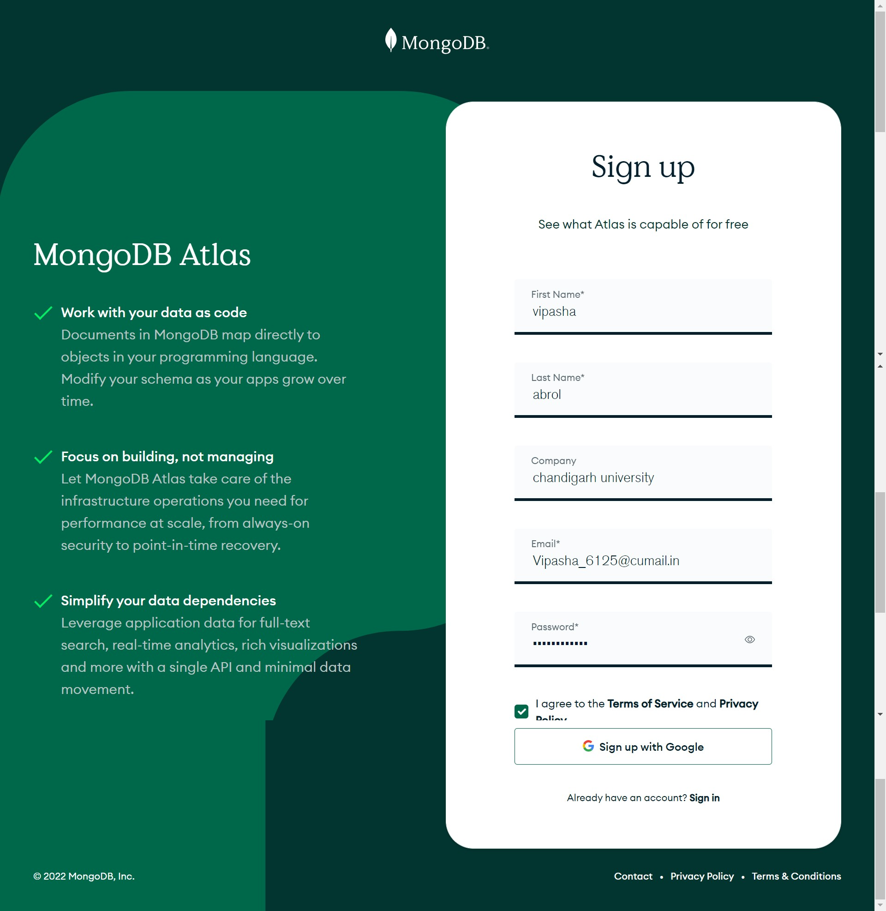
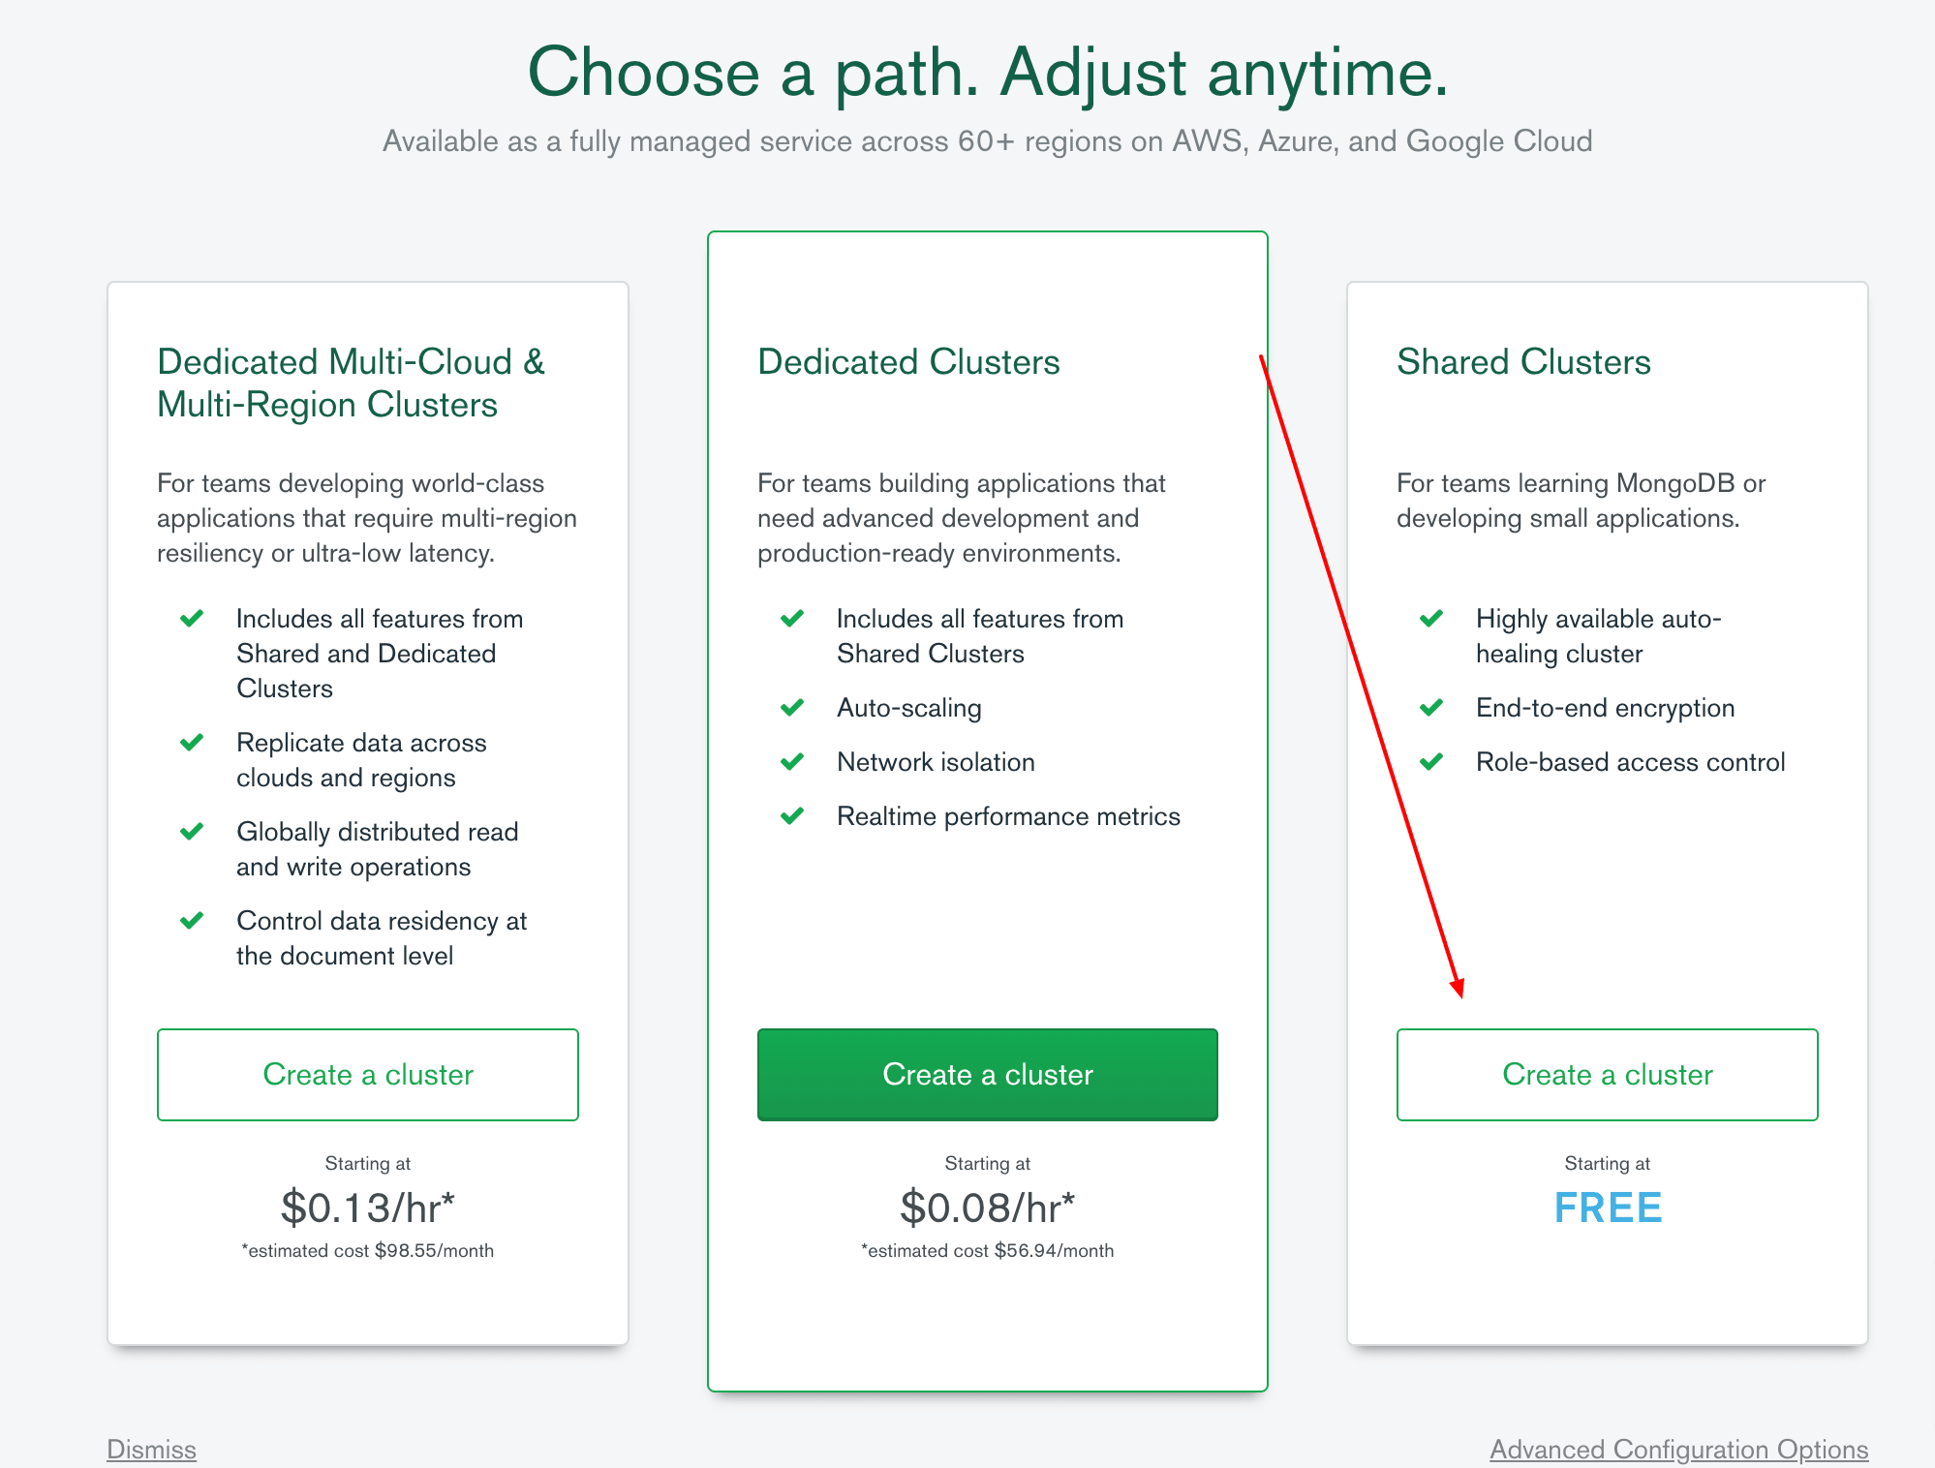
Create An ATLAS Account
Wait for the cluster to be created; it takes about 5 - 7 mins.
By visiting All Clusters, you will be able to see all the created Clusters. You can navigate to the current cluster to view its details and edit.
Step 1.
Step 5.

Slide 7
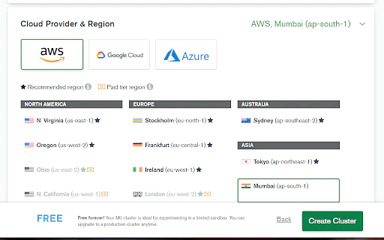
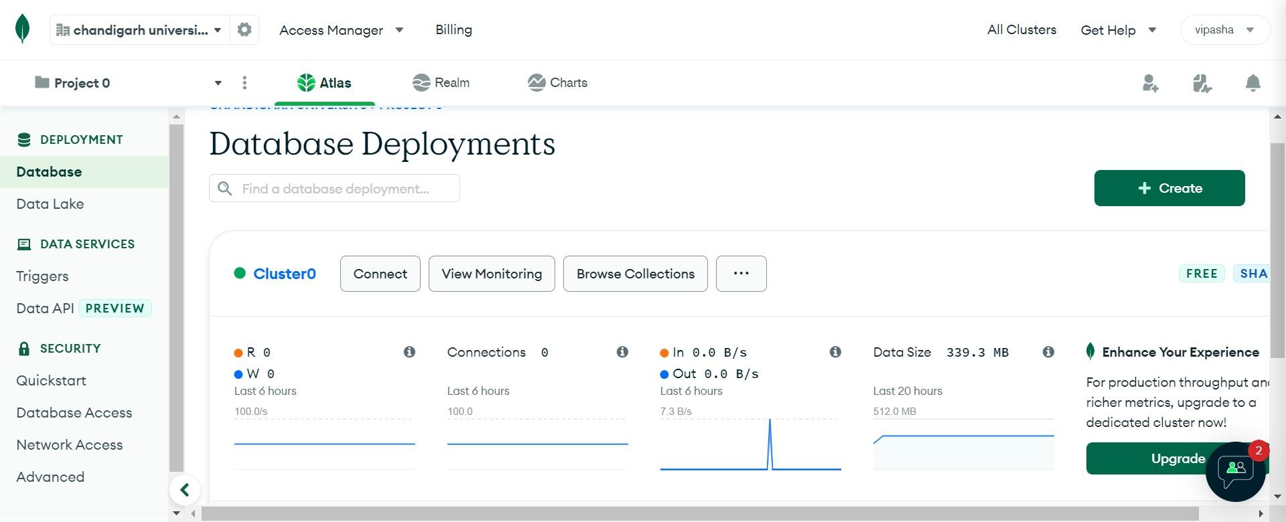
Create An ATLAS Account
Hkkf
By visiting our current cluster, we notice that MongoDB Atlas has selected the M0 Sandbox by default, and through registration, MongoDB Atlas creates a default organization for us.
Now it's time to Whitelist our Connection IP Address of the MongoDB Atlas Cluster.
Step 6 .
Step 7.

Slide 8
HOW TO WHITELIST YOUR CONNECTION IP ADDRESS
An IP Address provides a unique identifier to the network connecting device.
Atlas allows only clusters from trusted IP addresses to get connected. Known as Whitelist, an inventory of really trusted IP addresses is created to enable cluster connection and data access. Before connecting to our MongoDB Atlas cluster, we need to Whitelist our IP Address Connection.
STEP 1. Click on Connect in the cluster dashboard.
STEP 2. Click on Add Your Current IP Address.
STEP 3. Click on Add IP Address.

Slide 9
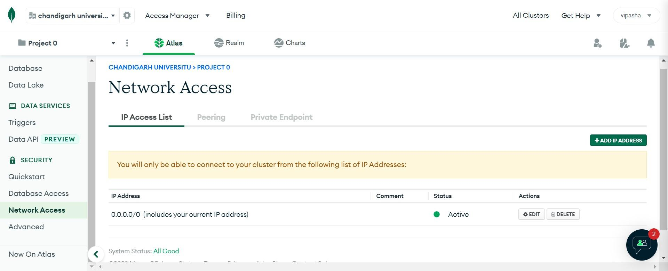
HOW TO WHITELIST YOUR CONNECTION IP ADDRESS
Creating a MongoDB User for our Cluster: For security purposes, Atlas requires clients to authenticate as MongoDB users to access the cluster. We must create a MongoDB user to access our cluster. MongoDB users are separate from Atlas users:

Slide 10
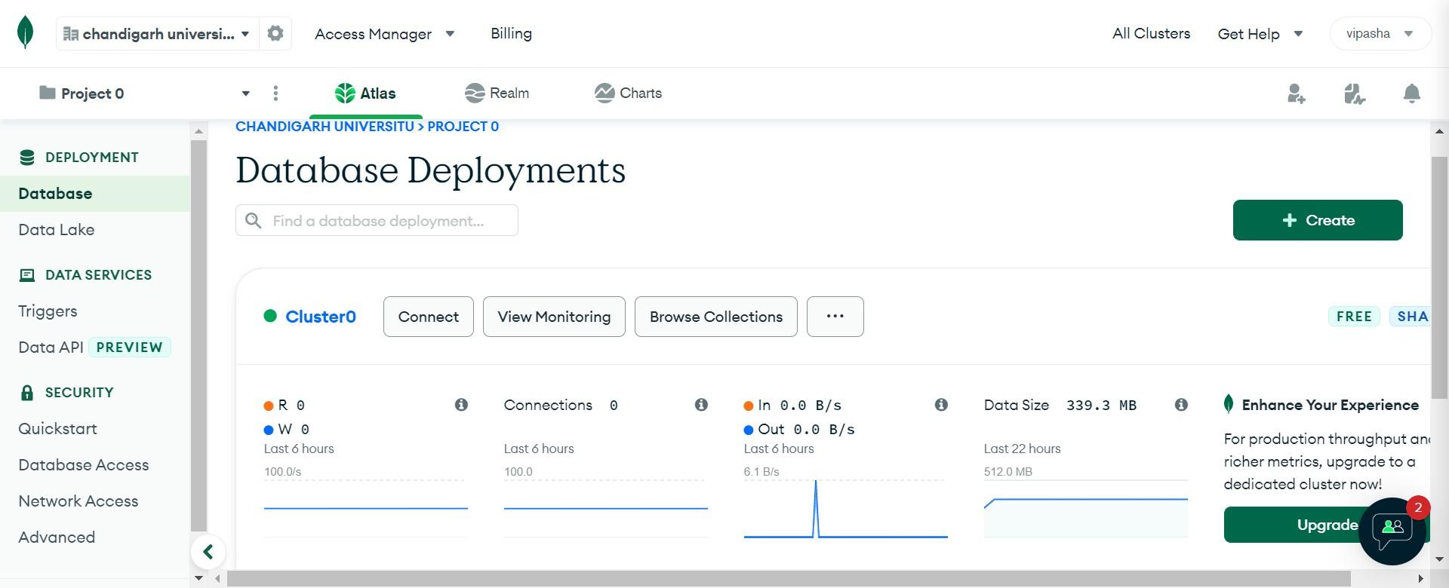
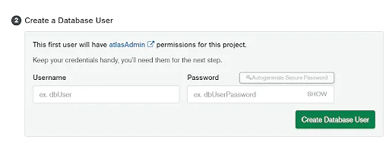
MongoDB users can access a database hosted in Atlas.
Atlas users can log into Atlas but do not have access to MongoDB databases.
Step 1: From the Cluster View, click on Connect button.
Step 2: Add a username and password in the Create Database User section

Slide 11

Step 3: Click on Create Database User
CONNECT TO CLUSTERS
Step 1: Click on Connect on the Cluster dashboard.
Step 2: Click on Connect with the MongoDB Shell.
Step 3: If you do not have MongoDB shell installed, click on the left bar.
Step 4: Select your operating system and click on download.
Step 5: Now extract the MongoDB zip file and add the system path of the MongoDB Shell path in the system environment variables as shown below.
Step 6: To check if the MongoDB shell is correctly installed in your computer, run the following command in your command prompt (cmd)-
mongosh - - v
Step 7: Now go back to your Cluster view and select “I have MongoDB shell installed”.

Slide 12
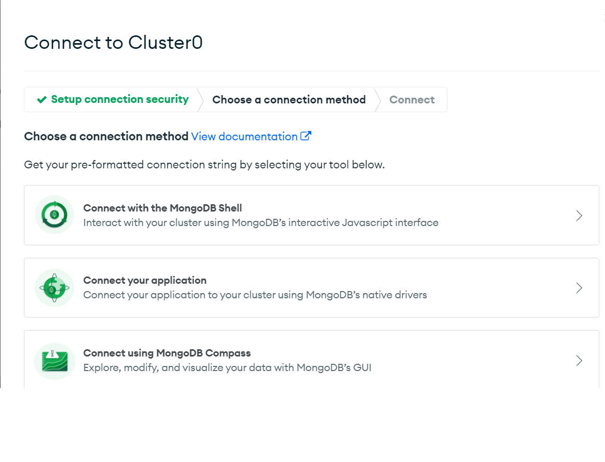
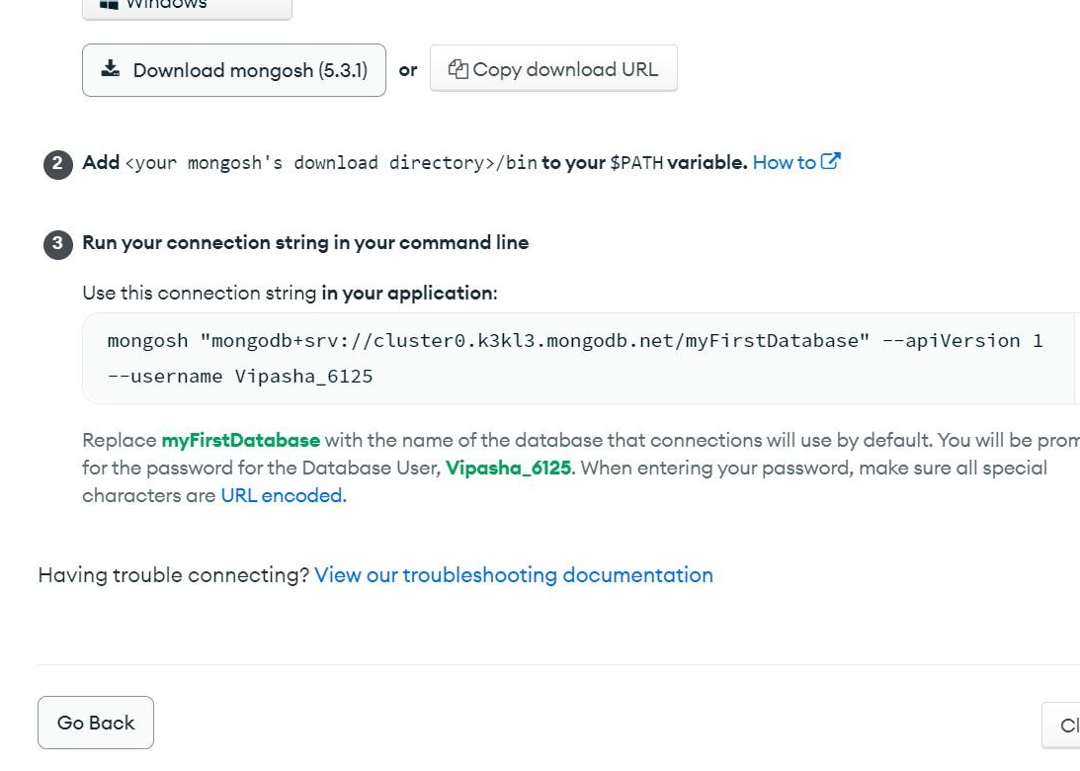
Step 8: Copy the given connection string, paste it in the cmd and run it.
Step 9: Enter the MongoDB database password to proceed.
Now that our connection is made let us interact with this MongoDB cluster.

Slide 13
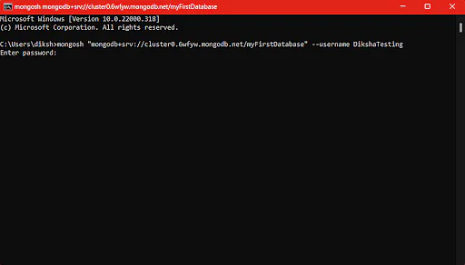
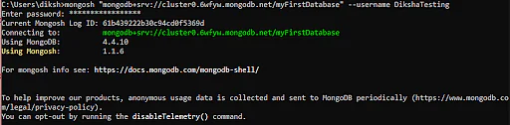
Insert and View Data in Your Cluster:
For interacting with the MongoDB cluster, we need to use the Data Explorer of MongoDB Atlas.
Data Explorer helps us to create, view, and drop databases. We can edit, delete and insert documents and run and create aggregation pipelines to process our data. Data Explorer allows us to access and manage data inside our clusters, unlike MongoDB Compass.

Slide 14
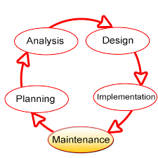
SDLC(Systems Development Life Cycle)
The Systems Development Life Cycle (SDLC) is a process used in the development, creation, and maintenance of an information system. This process is often used in the creation or updating of a database system, and can serve as a useful tool for anyone trying to undertake a large database project.
The System Development Life Cycle (SDLC) has five phases: The Planning phase, the Analysis phase, the Design phase, the Implementation phase and the Maintenance Planning of the SDLC.

Slide 15
PHASE 1: Planning
During this phase, the group that is responsible for creating the system must first determine what the system needs to do for the organization (requirements gathering). Often this means asking questions such as..
•What do we need this system for ?
•What will the system do for the organization ?
•How are we going to make this system ?
•During this initial phase, resources (both human and technology resources) are put together and a project plan is devised by the project manager.
Participants in the SDLC’s initial assessment must begin to study and evaluate alternative solutions. If it is decided that a new system is necessary, the next question is whether it is feasible. The feasibility study like The technical aspects of hardware and software requirements, The system cost, The operational cost must be evaluated.

Slide 16
Phase 2: Analysis
The Analysis Phase the second phase of the SDLC and is when the group that has been placed in charge of the project must decide if the project should go ahead with the resources available. This also includes looking at any existing system to see what it is doing for the organization and how well that system is doing its job. The feasibility of the project is also considered, and the group has to ask questions such as...
•Can this system be created with the resources (and budget) we have available?
•Will this system significantly improve the organisation?
•Does the old system even need to be replaced?
The analysis phase of the SDLC is, in effect, a thorough audit of user requirements.The existing hardware and software systems are also studied during the analysis phase. The result of analysis should be a better understanding of the system’s functional areas, actual and potential problems, and opportunities.
The analysis phase also includes the creation of a logical systems design. The logical design must specify the appropriate conceptual data model, inputs, processes, and expected output requirements.

Slide 17
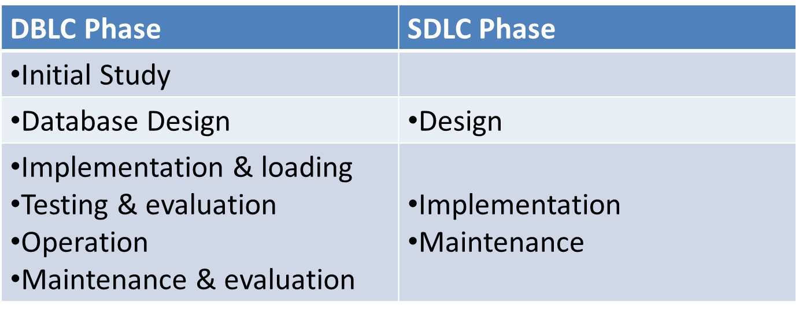
Comparison to DBLC
The SDLC can be compared to the DBLC with the combination and splitting of a few phases in both systems:

Slide 18
Android with Kotlin
•Kotlin is a cross-platform programming language that may be used as an alternative to Java for Android App Development.
•Kotlin is much simpler for beginners to try as compared to Java.
•Kotlin is sponsored by Google, announced as one of the official languages for Android Development in 2017.
Kotlin programming language is multi-platform, i.e. easily executable on a Java Virtual Machine.
Benefits:
Less code combined with greater readability.
Mature language and environment.
Kotlin support in Android Jetpack and other libraries
Code safety.

Slide 19
What does Kotlin first mean?
When building new Android development tools and content, such as Jetpack libraries, samples, documentation, and training content, we will design them with Kotlin users in mind while continuing to provide support for using our APIs from the Java programming language.
EXAMPLE
fun main()
{
println("Hello Geeks");
}

Slide 20
Key Features of Kotlin:
Statically typed – Statically typed is a programming language characteristic that means the type of every variable and expression is known at compile time.
Concise – It drastically reduces the extra code written in other object-oriented programming languages
Safe – It provides the safety from most annoying and irritating NullPointerExceptions by supporting nullability as part of its system.
Interoperable with Java – Kotlin runs on Java Virtual Machine(JVM) so it is totally interoperable with java.
Functional and Object Oriented Capabilities – Kotlin has rich set of many useful methods which includes higher-order functions, lambda expressions, operator overloading, lazy evaluation, operator overloading and much more.
Compilation time – It has higher performance and fast compilation time.
Tool- Friendly – It has excellent tooling support.

Slide 21
Applications of Kotlin language:
You can use Kotlin to build Android Application.
Kotlin can also compile to JavaScript, and making it available for the frontend.
It is also designed to work well for web development and server-side development.

Slide 22
Practice Questions
: How we create database in Mongo DB?
How we can we setting up cluster in Mongo DB Atlas?

Slide 23
Interview Questions
Where do we use MongoDB?
What is the difference between MongoDB and RDBMS
How to do transactions/locking in MongoDB?
What are the features you think are there in Kotlin but not in Java?
Explain Kotlin’s NULL safety?

Slide 24
References
https://www.mongodb.com/docs/atlas/
https://www.mongodb.com/presentations/mongo-db-atlas-101-e-workshop
https://www.simplilearn.com/tutorials/mongodb-tutorial/what-is-mangodb-atlas-database
https://www.javatpoint.com/mongodb-atlas
https://www.tutorialspoint.com/mongodb/mongodb_environment.htm#
http://www.myreadingroom.co.in/notes-and-studymaterial/65-dbms/505-the-system-development-life-cycle.html
https://www.tutorialspoint.com/system_analysis_and_design/system_analysis_and_design_development_life_cycle.htm
https://www.geeksforgeeks.org/introduction-to-kotlin/

Slide 25
Thank you

